Slide 1

National Honor Society
December 2025 - 4th Meeting

Slide 2
Leadership Contact
President: Lily Arnold - lilyba@madisoncity.k12.al.us
Vice President: Krishnam Maisuria - krishnamcm@madisoncity.k12.al.us
Sponsor: Mr. Thomas - jlthomas@madisoncity.k12.al.us

Slide 3
New Officers!
Secretary: Tabytha Hartland - tabythajh@madisoncity.k12.al.us
Parliamentarian: Prakya Velagapudi - prakyav@madisoncity.k12.al.us
Treasurer: Clara Maehlmann - claraem@madisoncity.k12.al.us
Historian: Aneesh Maruvada - aneeshcm@madisoncity.k12.al.us

Slide 4
Starting this meeting, we will have a required password to submit the attendance form
Please get out your school Chromebook and open the attendance Google Form.

Slide 5
NHS Oath
I pledge to maintain high scholastic standing,
To endeavor intelligently and courageously to be a leader,
To give of myself freely in service to others,
And to hold as fundamental and worthy an untarnished character.
In so doing, I shall prove myself worthy
Of a place in the National Honor Society

Slide 6
New Member Expectations
General requirements:
  Be a sophomore, junior, or senior
  Have a weighted GPA of 3.75 or higher
  Complete 20 service hours by April and attend the Induction Ceremony in May
  Complete and submit a new member application by September 12
Turn in a HARD COPY of the application to Mr. Thomas in A109.
  Place your application in a large envelope
  Include your updated report card and new member dues ($20) in the envelope
    Print your report card from PowerSchool

Slide 7
Membership Requirements
Complete 20 service hours by April
  Save all physical copies of completed service hour sheets to turn in by April
  Scan and keep duplicate copies of your original service hour sheets to have for proof if the original copies get lost in the submitting process.
Maintain a weighted 3.75 GPA throughout the school year
Attend the mandatory monthly meetings
  Attendance QR code is the last slide of every meeting
  2 excused absences allowed
    Complete the Absence Form that is sent out in the ParentSquare

Slide 8
Community Service
Must be unpaid volunteer work that helps the community
  What DOES NOT count: paid work, tutoring and/or babysitting a family member
Double-dipping allowed for this year
Hours will NOT be accepted without proper documentation!
Keep all original service hour record sheets and their duplicate copies in a safe place until the April deadline.

Slide 9
Service Hours Guidelines:
20 Service hours must be completed by the first week of April
10 hour caps are placed upon the following service activities:
  Summer Hours (June-July)
  Weekly Religious Events
  Donations
You must utilize the Service Hour Form on the JC Website
  Hours not documented with supervisor signature will not be counted!

Slide 10
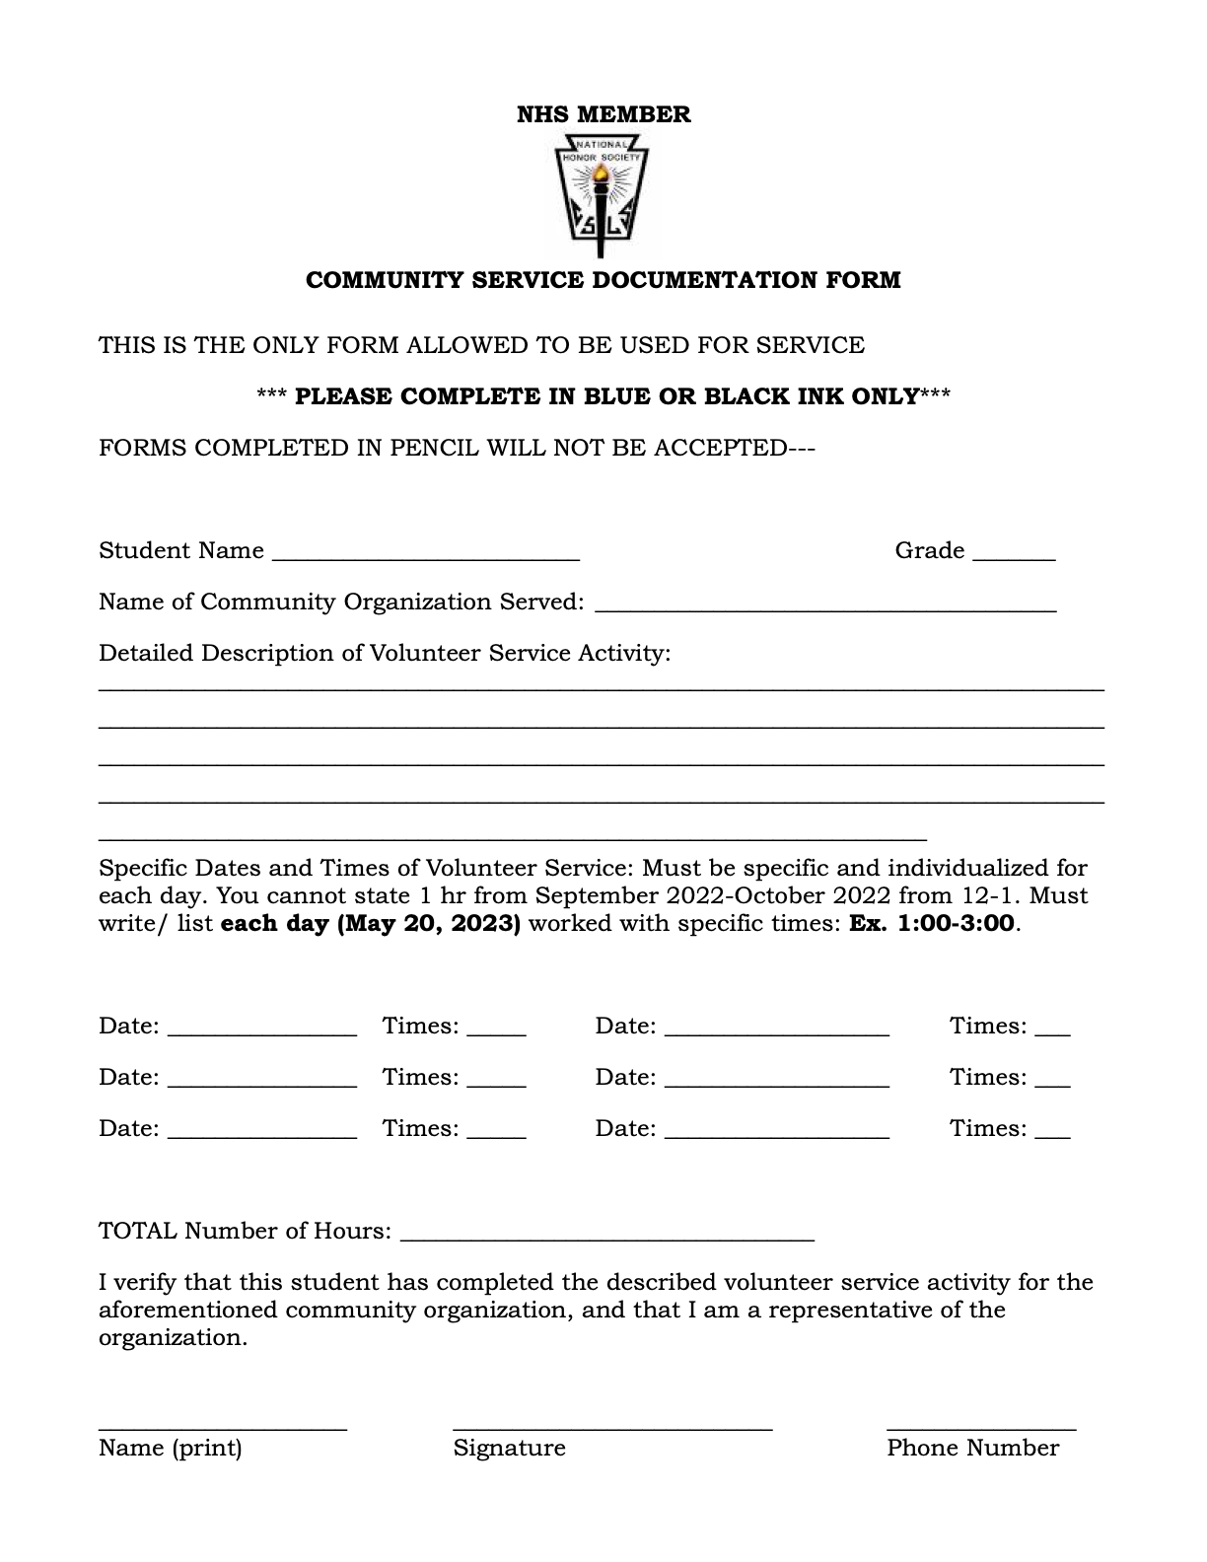
Community Service Form:
Linked on the JC website → Clubs and Organizations → NHS

Slide 11
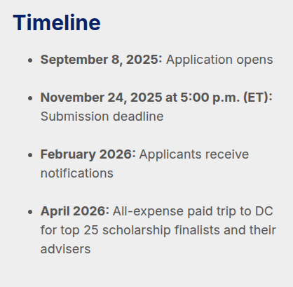
Seniors - NHS Scholarship
Keep an eye out for these dates if you applied
nationalhonorsociety.org

Slide 12
Volunteer in the Garden- Huntsville Botanical Garden
Weekdays (daytime, evenings), Weekends (daytime, evenings)
Volunteer opportunities vary in length of time based on the availability of the individual as well as the task or event chosen.
Community Development, Environment & Sustainability
Participation Requirements: Attend Orientation
Age Requirement: 16+
Volunteer Application Link:
https://ideali.st/qXWh8n

Slide 13
Huntsville Animal Services
Volunteers needed any time the shelter is open
  Monday-Friday (9am - 5pm), Saturday (9am - 3pm)
Volunteers can choose to help with activities with or without direct contact with animals.
Volunteers must be at least 16 years of age, and those under 18 need a consent form from a guardian.
Application Link:
www.huntsvilleal.gov/

Slide 14
Manna House Food Distribution Center
Assist with food preparation and distribution, clothing distribution, etc. for the less fortunate on Mondays, Wednesdays, and Thursdays from 1:00pm-6:30pm.
Help set up and serve at outdoor church events for the less fortunate on Saturdays from 11:00am-1:00pm.
Always in need of toilet paper and grocery bag donations.
More information can be found at: https://mymannahouse.com/get-involved/

Slide 15
Free 2 Teach
Job #1: “Assist with Teacher Shopping” - help teachers with their shopping, check them in and out, restock school supplies and other goods for teachers.
  Tuesdays & Thursdays 3:00pm-6:00pm
  1st Saturday of every month during the school year 9:00am-12:00pm
You MUST register as a volunteer with Free2Teach and register for a shift via the Free2Teach website
Sign Up Link + More Information: https://free2teach.org/impact/volunteer/

Slide 16
Downtown Rescue Mission Thrift Store
Come ANYTIME between 9am - 7pm to volunteer your time organizing and reshelving clothing, tidying up, and helping the community.
Volunteers are in greater need on Specialty days (Half-price, Super Saturdays, etc.)
Upon arrival, ask a cashier for the Volunteer book and sign in.
https://www.downtownrescuemission.org/thrift-stores

Slide 17
ShowerUp
Help those experiencing homelessness by providing showers, hygiene resources and personal care.
Volunteers can do a variety of things such as: handing out hygiene kits, cleaning showers, assigning people showers, and washing towels.
Location: Rose of Sharon Soup Kitchen - 723 Arcadia Cir NW Huntsville AL 35801
You must sign up to be a volunteer through their website before signing up for events
Check their website for when volunteering hours are available.

Slide 18
Merrimack Hall
Volunteers assist with art classes of all sorts catered towards special needs youth within the Huntsville area.
Classes to help with include: pottery, dance, fitness, music, games, acting, yoga, art, and more.
Location: Merrimack: 262 Miller Lane Owens Crossroads AL 35763
Check out their website for more information on how to sign up
Link: https://merrimackhall.com/

Slide 19
EarlyWorks - 12 Nights of Santa
WHEN: December 12th – 23rd beginning at 3pm weekends and week of Christmas, 5pm weekdays
WHERE: EarlyWorks Children’s Museum
Hosted at EarlyWorks Museum, 12 Nights of Santa is a magical holiday experience for the entire family to enjoy!
Volunteer as a costumed character or work at ELF stations
Sign up to volunteer here: https://earlyworks.com/memberships-giving/volunteer/
15 or under must be supervised by an adult

Slide 20

Workshop: Interview Tips and Tricks

Slide 21
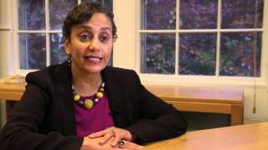
College and Career Interview Tips
Notes:
Stop at 3:55

Slide 22
December Meeting Password
Please type in all caps.
This is required to submit the attendance form.
Notes:
The December meeting password is: DECELEVENTH

Slide 23
New Members join the ParentSquare Group:
ParentSquare Link: https://www.parentsquare.com/groups/join/nnjxatobtn
Slides will be posted on the NHS club page on the JCHS website
Attendance form posted on ParentSquare and will close at the end of Refuel
Students, if you would like your parents to be included into the ParentSquare, send them the link above.

Slide 24
Students listed below, please come up to the stage
Kyler Haverty
Daniel Hso
Yashri Patel
Fiona Scully
Savannah Velez

